Slide 1
Tamil Text To English Emotional Speech Conversion
Using UNL For Translation
Team - H15
Archana B - 2011103505
Siva M R - 2011103536
Jayavasanth R - 2011103562
MENTOR:
Dr. RAJESWARI SRIDHAR

Slide 2

Our project involves the translation of text from Tamil to English followed by the synthesis of speech from the converted English text using a Text-To-Speech engine.
This speech will be made humanised by analysing emotions and adding prosodic content to the speech.

Slide 3

Expressing the sense of words or text in another language is translation.
6500 spoken languages have been recognized till date. In order to lift the cross-cultural barrier caused by the absence of a universally spoken language (English is spoken by appr. 20% of the world population), translation is essential.

Slide 4

While English is the 2nd most spoken language in the world, Tamil is the 15th most spoken language. This necessitates the need for a medium of translation between the two languages for those speakers who know only one of the two languages.
Official documents , school samacheer text books and even dialects in Tamil could be hereby voiced providing a great value.
Voice output would be beneficial to the blind.

Slide 5

Rule based translation
Phrase based translation
Example based translation
Content based translation
Hybrid approach – Interlingua based

Slide 6

Example based Translation needs a very huge parallel data corpus.
BLEU Score for Tamil to English translation with a corpus of 75,000 words is 0.26
In word-by-word and Phrase based Translation the language specific grammar is not preserved.
Preserving the sentence meaning.
Word sense disambiguation.
Handling exceptions like phrases and idioms.
Adding emotions to voice at the signal level is difficult is because it is hard to predict the part of the word that needs to be modified.

Slide 7

Paper Title and Authors | Concepts Discussed | Drawbacks
Tamil to UNL EnConverter (2002). T.Dhanabalan,K.Saravanan T.V.Geetha | Rule based approach Tags 46 UNL relations to one or more Tamil inflictions | Simple UNL graphs only constructed Requires domain analysis to remove ambiguity of relations
Morpho-Semantic Features for Rule-based Tamil Enconversion (2011). J Balaji , TV Geetha , Ranjani Parthasarathy, Madhan Karky | Rule based approach for forming UNL graphs Analyzing inflictions to relate UWs | No consideration about complex and compound Tamil Sentences Ambigious free word order sentences
Semantic Parsing of Tamil Sentences (2011). J Balaji , TV Geetha, Ranjani Parthasarathi | UNL Nested graph identification Uses mod, and, pos relations | No indications on punctuations Precision <60%

Slide 8

Paper Title and Authors | Concepts Discussed | Drawbacks
A hybrid approach to construction of Wordnet (2014). Jayavasanth R , Rajeswari Sridhar | Graph wordnet database with holonyms , meronyms , hypernyms and morph forms . POS equivalent translated words | No context based English equivalent analysis to distinguish words with same POS
A hybrid approach to Tamil Morphological generation (2014). Rajeswari Sridhar, Sugadev C, Manimurugesan P, Vignesh NT | Rule based approach to handle morphological analysis Uses a suffix table for inflections and generates inflected nouns and verbs | Rule based and so not flexible Does not handle all exceptions
Postagger and Chunker for Tamil Language (2009). Dhanalakshmi V., Anand kumar M., Soman K. P., Rajendran S. | Makes use of customized tagset to POS tag tamil sentences. Customised tagset reduces time and complexity increasing tagging accuracy

Slide 9
Paper Title and Authors | Concepts Discussed | Drawbacks
The production and recognition of emotions in speech: features and algorithms (2003). Pierre-Yves Oudeyer. | Emotions of Calmness , sadness , Anger , Comfort , Happiness have been incorporated. Variation in the age of the voice could be produced by overriding the sample rate. | Precision is less in this rule based approach
Emotions in the voice: Humanising a Robotic voice (2010). Tristan Bowles, Sandra Pauletto. | Uses copy synthesis or sound synthesis in which acoustic features are copied from real emotion portrayals. Modifying fundamental frequency and amplitude | The test subjects were able to recognize sadness positively but anger and happiness weren't distinguishable leading to wrong recognition of those emotions.
Adding an Emotions Filter to Malay Text-to-speech System (2006). Mumtaz Begum , Raja N. Ainon , Zuraidah M Don , & Gerry Knowles | Emotions filter was designed by manipulating pitch and duration using a rule based approach. For vowels, both pitch and duration is modified and for consonants, only the duration is modified. | The naturalness of the output could be better.

Slide 10
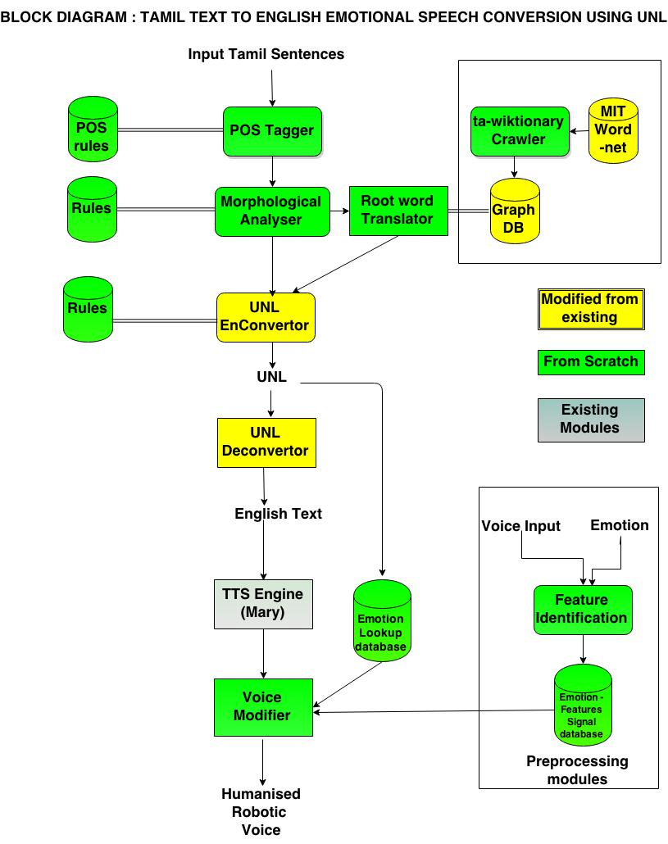

Slide 11

UNL – Universal Networking Language is a declarative formal language specifically designed to represent semantic data extracted from natural language texts by the UNDL
UNL can be used as an interlingua for conversion from source language to target language
Universal Words (UWs) are word expressing concepts that are linked with one another to form a UNL graph

Slide 12
Each universal word may have one or more properties denoted by Attributes . The attributes denote any one of tense ,mood , aspect , number etc., eg. Present , past , indefinite , entry
Two UWs are linked by a relation. The are 46 relations in UNL including pos , aoj , agt etc.,
Two UWs joined by a relation may form a hyper node. It is also called as scope . A scope indicates that all elements of the scope have to be translated together to a single phrase.
UNL Format : <relation> ( <uw1> , <uw2> )
Hyper nodes : <scope-ID> ( <node1> , <node2> )

Slide 13

sky (icl>natural world)
blue (icl>color)
[UNL]
[W]
Blue (icl>color) @past, @entry, @interrogative, @exclamation
Sky (icl>natural world) @def
[/W]
01 aoj 02
[/UNL]

Slide 14

UNL based translation is a hybrid approach.
UNL based translation will involve
  Enconversion
    Translating from Source language to UNL format based on rules.
  Deconversion
    Converting from UNL to target Language.
UNL based translation gives a better BLEU score.
  BLEU score of previous UNL based translation approach was 0.54

Slide 15
MODULE SPLIT UP
PREPROCESSED MODULES
  Word Net Construction - Siva, Jayavasanth
  Emotion – Features Database - Archana
  Construction
ONLINE MODULES
  POS tagging - Siva
  Morphological Analysis - Siva
  UNL En conversion - Jayavasanth
  UNL Sub graph Identification - Jayavasanth
  UNL De conversion - Jayavasanth
  Emotion Identification - Archana
  Voice Modification & Output - Archana

Slide 16
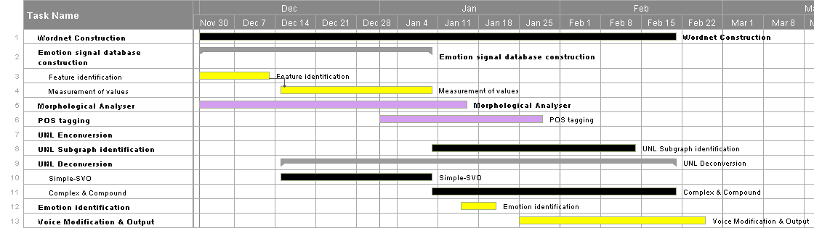
GANTT CHART

Slide 17
Tools
Eclipse IDE - For development
Neo4j - Graph database for wordnet
Simple NLG - Natural language generator from University of Aberdeen
Matlab - Emotion – feature database construction and Voice modification
Marytts - Text-To-Speech engine for speech generation
ROUGE - For LCS matching of actual and expected output.

Slide 18
Overall Algorithm
S → Sentence | S [x] → Sentence in Language X
GTTS → Generated Text to Speech
GenerateVoice( S [Tamil] )
  UNL , S [English] =Translate( S [Tamil] )
  Emotion = IdentifyEmotion ( UNL )
  GTTS = GenerateTTS ( S [English] )
  ModifyTTS ( GTTS , Emotion )

Slide 19
Overall Algorithm
E ← element ( word , punctuation)
Seg ← Segmented Word
Translate ( S [tamil] )
  UNL = Enconvert ( S [Tamil] )
  S [English] = Deconvert ( S [Tamil] )
Enconvert ( S [Tamil] )
  For each e_{i} in S
  POS_tag(e_{i} ) = Predictive_Pos_Tagging(Suffix_POS_Tagging(e_{i} ))
  Seg _{root, suffix}[i] = Morphological_Analysis ( e_{i} , POS_tag(e_{i} ) )

Slide 20
Overall Algorithm
  UW ← Universal Word
  UNL ← Universal Networking Language
  HN ← Hyper Node
  Rel ← UNL Relations
  For each S_{i} in Seg[ i ]
      UW [ i] = root [S_{i}]
      attributes [i] = Suffix_Analysis ( S_{i} )
  For each UW[i],Seg[i] in UW,Seg
      rel [k] = Suffix_analysis ( S_{i ,} S_{i + 1} ) + Domain_analysis ( root [ S_{i} ])
      HN[j] = Suffix_analysis ( S_{i ,} S_{i + 1 )}
      k++
  UNL = UW + Rel

Slide 21
Overall Algorithm
Deconvert ( UNL )
  For each hi in UNL.hyperNodes
  T_s[k]<- SimpleNLG(hi)
  S.English = SentenceGenerator (T_s[k])

Slide 23
POS TAGGER
Tamil is partial free word order language
Hence the inflections are analysed to find the POS of a particular word
Inflections such as ‘ aye’ added to words , denote that they are objects in that sentence
  Eg. Kaiyai pidathaan.
Words are scanned from right to left to handle vallinam-migum-idam
Uses a customized tagset tailored to fit the UNL relations
These tags are used in Morphological analysis and UNL graph construction

Slide 24
Algorithm
Split the input sentence into words
Right to left scanning of words
Remove “க், ச், த், ப்” if any at the end
Identify pronouns and assign doer.
Check if the word ends with vinaimutru vigudhi, if so assign verb tag and send it to verb analyser
Check if the word ends with vetrumai, if so assign Noun tag and send it to noun analyser
In case of a named entity transliterate it to English.
Eg சென்னை- chennai
Handle adverbs and adjectives separately.
Use a second pass to resolve ambiguity and word sense disambiguation.

Slide 25
Input, Output and Evaluation Parameters
Input:
அவன் புத்தகத்தை படிக்கிறான்
Output:
அவன் POS :pronoun POSid :2
புத்தகத்தை POS :object POSid :1
படிக்கிறான் POS :verb POSid :3
Evaluation Parameters:
Percentage efficiency of POS Tagger =
No of words correctly tagged by our tagger
----------------------------------------------------------------------------------------------------------------------------------------------------------------------------------------
No of words correctly tagged by human reference

Slide 26
MORPHOLOGICAL ANALYSER
Tamil is a morphologically rich language.
A number of words can be formed from a root word by adding inflections.
The inflected words are analyzed to split in to root word and inflections
The root word is ‘Universal Word’ (UW) in the UNL representation
Features like tense, gender and plurality extracted from inflections are used in Deconversion

Slide 27
Algorithm
If noun POS tag
  Identify the வேற்றுமை and word type (there are 16 word types and 7 வேற்றுமை types)
  Identify the sub-word type and extract the root word handling திரிதல், விகாரம.
  Assign noun suffix and plurality based on the identified word, sub-word and வேற்றுமை types and the result from wordnet

Slide 28
Rules
Noun inflection types :
    ஐ, ஆல், கு, இல், இன், அது, கண்,
Word types :
  சேயை, கடையை,
  கப்பலை, காலை
  புத்த்கத்தை
  கசப்பை
  சாப்பாட்டை
  காற்றை
  புள்ளை,
  காதை
  மண்ணை
  வேரை
  சோர்வை
  மானை
  காசை
  புத்தகங்களை, சொற்களை

Slide 29
Algorithm
If verb POS tag
  Identify the இடைநிலை and விகுதி type (there are 16 word types and 8 இடைநிலை types)
  Match the tense from இடைநிலை and doer from விகுதி.
  Extract the root word handling திரிதல், விகாரம்.
  Compare the root with wordnet and assign root word, tense, doer, plurality.
  வருவான் – வா + வ் + ஆன்
  வா → வரு என்றானது விகாரம்

Slide 30
Rules
இடைநிலைகள் :
    த், ட், ற், இன் - Past tense
    கிறு, கின்று - Present tense
    ப், வ் - Future tense
விகுதிகள் :
  (நடந்தேன்) ஏன்
  (நடந்தோம்) ஓம்
  (நடந்தாய்) ஆய்
  (நடந்தீர்) ஈர்
  (நடந்தீர்கள்) ஈர்கள்
  (நடந்தான்) ஆன்
  (நடந்தாள்) ஆள்
  (நடந்தார்) ஆர்
  (நடந்தார்கள்) ஆர்கள்
  (நடந்தனர்) னர்
  (நடந்தது) அது
  (நடந்தன) அன

Slide 31
Input, Output and Evaluation Parameters
Input:
  அவன்
Output:
  rootword: அவன்
  DoerSuffix :ஆன்
Input:
  புத்தகத்தை
Output:
  rootword: புத்தகம்
  NounSuffix :ஐ

Slide 32
Input, Output and Evaluation Parameters
Input:
  படிக்கிறான்
Output:
  rootword: படி
  TenseSuffix :கிறு
  DoerSuffix :ஆன்
Evaluation Parameters:
  Percentage efficiency of Morphological Analyser =
  No of root words correctly identified by our analyser
  --------------------------------------------------------------------------------------------------------------------------------------------------------------------------------------------------------------------------------------------------------------------------------------------------------------------------------------------------------------------------------------------------------------------------------------------------
  No of root words correctly identified by human reference

Slide 33
Word net Construction
Words from Madras institute Technology (MIT) wordnet and an existing wordnet [3] are used for this.
The missing English terms in the MIT wordnet are crawled from tawiktionary.
A graph based structure is used to represent the wordnet where in the root node will represent the Tamil word and edges with values as noun , verb , adverb will point to nodes with respective English translation.
Neo4j is used to construct the wordnet graph.

Slide 34
Structure of the wordnet
noun
moon
நிலவு
holonym
noun
planet
noun
மதி
respect
verb
கோள்
noun
wisdom

Slide 35
Structure of the wordnet
Nodes
  Tamil word
  English gloss
Relations
  Verb → connecting a tamil word with its verb gloss
  Noun → connecting a tamil word with its noun gloss
  Adjective → connecting a tamil word with its adjective gloss
  Adverb → connecting a tamil word with its adverb gloss
  Hyponyms , Hypernyms , Holonyms and Homonyms

Slide 36
UNL Enconversion and Subgraph Identification
The root word of each segemented word is modified in to a Universal Word
The tense suffix of the Segmented word is analysed to choose the tense attributes
Certain classifier words are used to determine other attributes like
  @def – antha , intha , athu , ithu
  @indef – oru , ondru , aega
  @continue – kolkindra
  @interrogation - ? , vanth‘aaya’ , sendr’aaya;
  @just – thatpothu , irpothu
  @not - alla , il , illai

Slide 37
UNL Enconversion and Subgraph Identification
  @exclamation - !
  @polite – thayavu
  @ability – iyalum , mudium
  @sufficient - mattume
After identifying the possible attributes , two passes are used to find relations between Uws
  The first pass is based on explicit verb ending
    eg . Avan puthagath’ai’ padithaan
  Tamil nouns are modified by the seven – ‘ai’ , ‘aal’ , ‘ku’ , ‘in’ , ‘athu’ , ‘kan’

Slide 38
UNL Enconversion and Subgraph Identification
Each of these suffixes denote one or more relationships eg.
  Avan kadai’ku’ senraan
    Here ‘ku’ denotes ‘gol’ – final place relation
  Avan puthagathai padithaan
    Here ‘ai’ makes the previous subject avan the agent – agt
The second pass is for hidden suffix verbs
  Avan puthagam padithaan
    Here there is no noun suffixes shown explicily . In these cases the trigram approach is used to resolve the relation type.

Slide 39
UNL Enconversion and Subgraph Identification
Then the HyperNodes in the sentence are identified based on explicit prefixes.
  Eg. Naan << puthi’ya’ puthagam >> ondrai vaanginen
The UNL graph will now consist of UWs with tamil root words
Based on the POS these Uws correspond to , the english equivalent of these words are fetched from the wordnet.
  Eg . Aadu , noun -> goat
    Aadu , verb -> dance

Slide 40
UNL Enconversion and Subgraph Identification
Input
    Tamil Sentence
eg. புத்தகத்தை படித்தான் அவன்
Output
    UNL expression
Eg. [UNL]
  [W]
  He @masculine
  book
  read @entry @present
  [\W]
  2 agt 0
  2 obj 1
  [\UNL]

Slide 41
UNL DeConversion
Conversion from the UNL structural language to the final target language, i.e, English is called UNL deconversion.
Deconversion is done with the help of Simple NLG
Each hyper node of the UNL graph is analysed starting from the lower most one in hierarchy. During each analysis , the verb , object , adverb and subject for each clause are found.

Slide 42
UNL DeConversion
Then using SimpleNLG – the English equivalent is generated.
Simple NLG allows creation of a sentence based on the clauses.
It also includes features to modify tense and type of sentence (interrogative , affirmative etc.,)

Slide 43
UNL DeConversion
Input : UNL
  Eg. [UNL]
    [W]
    He @masculine
    book
    read @entry @present
    [\W]
    2 agt 0
    2 obj 1
    [\UNL]
Output : English Sentence
    Eg.He reads book.

Slide 44
Evaluation
Translation will be evaluated using these measures with respect to a reference text (manually translated)
Word Error Rate
    W ER = (S+D+I)/N
  where
  – S is the number of substitutions,
  – D is the number of deletions,
  – I is the number of insertions,
  – C is the number of the corrects,
  – N is the number of words in the reference (N = S+D+C )

Slide 45
Evaluation
BLEU Score (Bilingual Evaluation Understudy)
    N-gram coherence based evaluation – We would be using bigram based evaluation.
      pn (∑Cϵ{Candidates}∑∑n−gramϵCCountclip(n−gram))
      = ----------------------------------------
      (Cϵ{Candidates}∑n−gramϵCCount(n−gram))
ROUGE, or Recall-Oriented Understudy for Gisting Evaluation
  We would evaluate ROGUE-L which is based on LCS matching of actual and expected output.
Rlcs = ( LCS(X,Y )) / length of x

Slide 46
Evaluation
METEOR (Metric for Evaluation of Translation with Explicit ORdering)
  METEOR is better than any other metric in the sense that it doesn’t check only the word but also the words stemmed from it and synonyms of it.
  M = F_{mean}(1 − p)
    where M denotes the scoreand p denotes the penalty computes as p = 0.5(c/u³_{m}) where c is number of chunks of data , u_{m} is the number of unigrams that have been mapped.

Slide 47
MaryTTS- A TTS synthesis platform
MaryTTS is an open-source, multilingual Text-to-Speech Synthesis platform written in Java
Speech is synthesised in 4 stages as:
Preprocessing-tokenising
NLP- Calculation of phone symbols and intonation
Calculation of acoustic parameters
Synthesiser-creates sound file

Slide 48
EMOTION-FEATURES DATABASE CONSTRUCTION
Input
  Voice samples are taken and studied to identify their characteristics.
Feature extraction- using MATLAB, AUDACITY & PRAAT
  Various features of speech like fundamental frequency, intensity are tabulated for each voice input.
  The values of each of these parameters for each emotion is identified.

Slide 49
Corpus
The voice samples are obtained from 3 female speakers who have similar speech characteristics as that of Marytts’ voice.
7 sentences are recorded in a variety of emotions such as angry, happy, sad and neutral.

Slide 50
Corpus processing
The sentences are read into Audacity, an audio analysis software in order to distinguish between the word boundaries clearly and to split them into audio files corresponding to each word.
If excess noise has been recorded, then using the noise removal feature of Audacity, the audio sample can be made relatively noise free.

Slide 51
Fundamental frequency estimation using MATLAB
Matlab is a high performance computation tool integrating computation, visualisation and programming, thereby making it very easy to solve complex problems.
The processing of speech requires a lot of analysis of sample data and application of many transformations such as the FFT, windowing etc, and Matlab is very flexible as it provides intuitive functions for all these.
In this project, Matlab is used for analysis of speech inputs by measuring and being able to modify qualities of speech such as frequency, amplitude etc.

Slide 52

Algorithm to determine fundamental frequency F0 in MATLAB
INPUT: sample voice signal showing a certain emotion such as happiness/sadness/anger.
F0 estimation using the complex cepstrum
Load speech waveform along with sampling frequency into matlab workspace.
Perform fourier transform of windowed signal
Y=fft(x.*hamming(length(x)))
Cepstrum is determined as the DFT of log spectrum
C=fft(log(abs(Y)+eps))

Slide 53
Algorithm to determine fundamental frequency F0 in MATLAB
Fundamental frequency is determined from cepstrum as
-[c,fx] = max(abs(C(ms1:ms20)))
-F0 = fs/(ms1+fx-1) is fundamental frequency

Slide 54
In time domain using autocorrelation:
This method is used to verify the frequencies obtained from cepstrum.
Algorithm :
(samples,sampling rate)] <–wavread(audio file)
millisecond2<– sampling rate / 500
millisecond20<– sampling rate /50
rvalue<– XCorrelation(samples, millisecond20)
(rmaxvalue ,tx) <– max(rvalue(millisecond2: millisecond20))
Fundamental frequency <– fs/(millisecond2+tx-1)

Slide 55
DETERMINATION OF DURATION OF EACH WORD – USING AUDACITY
This is measured using Audacity that has a millisecond calibration so that the exact duration of every word can be estimated.

Slide 56
INTENSITY ESTIMATION-USING PRAAT
Generally, words said with different emotions differ in the intensity with which they are spoken.
For eg, when a person speaks with anger, there is a greater intensity in the voice than when compared to a person who speaks with sadness.
So, this measurement is done with the help of PRAAT tool, that can accurately measure with what intensity the word was spoken. It is measured in decibels.

Slide 57
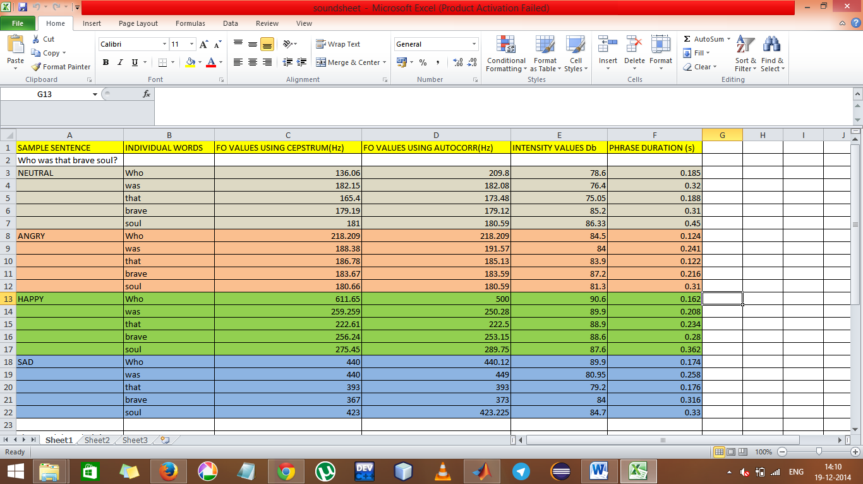


Slide 58
Evaluation Parameters
The number of variations between the values of F0 determined in time domain and frequency domain.
The number of values of F0 that are harmonics i.e, multiples of fundamental frequency F0.

Slide 59
Emotion Identification
The emotion present in the sentence is calculated by using the output of the UNL which is annotated with the tone of the sentence.
Various degrees of emotion can be identified based on the strength of the words that are used in the sentence.
After this has been estimated, it is mapped onto one of the emotions that have been handled in the emotion-features database.

Slide 60
Emotions Proposed to be Handled
Happiness
Sadness
Anger
Fear
Boredom

Slide 61
Voice Modification
The output of the text to speech system is modified to add the prosody.
The emotion features database is consulted and the corresponding values of various parameters (like fundamental frequency, intensity, duration etc) are calculated.
Then the robotic voice is modified based on the values of these parameters to produce the humanised voice.

Slide 62
Evaluation Parameters
Using a public poll to determine
On a scale from 1 to 5
how emotional the final output is by comparing it with (robotic) output from Marytts.
What emotion is expressed by the output
If the emotion conveyed by the input is the same as identified from UNL.

Slide 63
TEST CASES FOR TRANSLATION
TC – 01
அவள் பள்ளிக்குச் செல்கிறாள்.
She is going to school.
TC – 02
கன்னகி மதுரையை எரித்தாள்.
Kannagi burnt Madurai.
TC – 03
அவன் பந்து எரிந்தான்.
He threw a ball.
TC – 04
அவள் மகிழ்ச்சியில் ஒடினாள்.
She ran happily.
TC – 05
அவன் சோகத்தில் அழுதான்.
He wept in sorrow.

Slide 64
TEST CASES FOR TRANSLATION
TC – 06
கண்ணன் கடையில் புத்தகம் வாங்கினான்.
Kannan bought a book in the shop.
TC – 07
அவர்கள் அழகிய மானைக் கண்டனர்.
They saw a beautiful deer.
TC – 08
வைகை மதுரையில் உதயமாகிறது.
Vaigai originates in Madurai.
TC – 09
அவன் சென்னையைச் சேர்ந்தவன்.
He belongs to chennai.
TC – 10
சென்னை தமிழ்நாட்டின் தலைநகரம்.
Chennai is the capital of Tamil Nadu.

Slide 65
TEST CASE FOR VOICE MODIFICATION
Input: Speech without emotion, Identified emotion.
Expected Output: Speech with ’identified emotion’ incorporated.
TEST CASE FOR EVALUATION OF TRANSLATION
Input: Entam corpus v2.0 - news domain corpus
Output is evaluated with the parallel sentences.

Slide 66

[1] Sudhakar Sangeetha, Sekar Jothilakshmi, “Syllable based text to speech synthesis system using auto associative neural network prosody prediction”, In
International Journal of Speech Technology, Vol-17, Issue-2, pp 91-98, 2014.
[2] Dave S., Parikh J. and Bhattacharyya P., ”Interlingua Based English Hindi
Machine Translation and Language Divergence, Machine Translation”, Journal
of Machine Translation, Volume 16, pp.251-304, 2001.
[3] Dhanalakshmi V., Anand kumar M., Soman K. P. and Rajendran S., ”Postagger and Chunker for Tamil Language”, Proceedings of the 8th Tamil Internet Conference, Cologne, Germany, 2009.
[4] Rajeswari Sridhar, Sugadev C, Mani Murugesan P, Vignesh N T, ”A hybrid
approach to Tamil Morphological generation”, 13th International Tamil Internet
Conference, pp 101- 105, Pondicherry, 2014.
[5] T. Dhanabalan, K. Saravanan & T.V. Geetha, "Tamil to UNL EnConverter" , Proc. International Conference on Universal Knowledge and Language, Goa, India, 2002.

Slide 67
[6] J Balaji, T V Geetha, Ranjani and Madhan Karky, "Morpho-Semantic Features for Rule-based Tamil Enconversion", International Journal of Computer Applications 26, pp 11-18, July 2011.
[7] Balaji J, Geetha T V, Ranjani Parthasarathi, “Semantic Parsing of Tamil Sentences”, Proceedings of the Workshop on Machine Translation and Parsing in Indian Languages (MTPIL-2012), pp 15–22, COLING 2012, Mumbai, December 2012.
[8] Tristan Bowles, Sandra Pauletto, “Emotions in the Voice: Humanising a Robotic Voice.” Proceedings of the 7th Sound and Music Computing Conference, Barcelona, Spain, 2010.
[9] Jayavasanth R ,Rajeswari Sridhar “A hybrid approach to construction of Wordnet ” 13th Tamil Internet Conference, International Forum for Information Technology in Tamil, Pondicherry, pp-120, 2014.

Slide 68
[10] Lin, Chin-Yew and Franz Josef Och. “Automatic Evaluation of Machine Translation Quality Using Longest Common Subsequence and Skip-Bigram Statistics”, In Proceedings of the 42nd Annual Meeting of the Association for Computational Linguistics (ACL 2004), Barcelona, Spain, July 21 - 26, 2004.
[11] Mumtaz, B., "Adding an Emotions Filter to Malay Text-to-Speech System", Master Thesis, University of Malaya, Malaysia, 2006.
[12] Pierre-Yves Oudeyer , “The production and recognition of emotions in speech: features and algorithms” , ” International Journal of Human Computer interaction, 59, pp 157–183, 2003.
[13] Ramasamy, Loganathan; Bojar, Ondřej and Žabokrtský, Zdeněk, “EnTam: An English-Tamil Parallel Corpus (EnTam v2.0)”, LINDAT/CLARIN digital library at Institute of Formal and Applied Linguistics, Charles University in Prague, 2014.

Slide 69

THANK YOU !

